Slide 1
It’s a bird! It’s a plane!
It’s a bird…
Visualising Australia’s Birds
Monash University Data Analytics Bootcamp
Lindsay McCulloch
Sri Penumatcha Vrinda Patel
Yashada Kulkarni
Feb 2024 – Aug ’24 cohort
Project 3, Team 4

Slide 2


There is a breed of people out there who don’t just sit on a couch all weekend but step outside with a pair of binoculars…and watch birds. Yes, birds. (And yes, the feathered kind.)
Birders have been collecting data on bird sightings across the world and for centuries. It can be used to track changes in bird migrations, how they are impacted by climate change, roads and agricultural fields.
This data is priceless.
An enterprising group of scientists at the Cornell Lab of Ornithology started a citizen science project called eBird and they have been collecting birding data. This data that can drive our understanding of the avian world.
Notes:
you dont have to be a scientist

Slide 3

Our original research questions:
Migratory bird species arrival in Australia over time & possible trends
Flat file for download
~30 GB!
need to write to them to get access and it takes some time
API with limitations
- recent observations: 30 days limit!
- historic data available but not enough filters
-readily available
Our use case:
In the past 30 days:
How many species were observed, and how many individual observations were made; for Australia and for each state
Which species were observed and where?
Which birding spots had max species diversity?
Which were the 10 most commonly observed species, Australia-wide and state-wise
Which species were least common?
Which birding spots had max observations, Australia-wide and state-wise
State-wise what are the “notable” observations of birds?
Who were the top 10 observers per number of observations in each state?

Slide 4
eBird API
Cleaned location names, used google api
Create an ERD,
Create tables in PostgreSQL,
Import it & query
Create static visualisations in python
Create an interactive dashboard in js
New modules used: Echart in JavaScript, Bokeh & Holoviews in Python

Slide 5
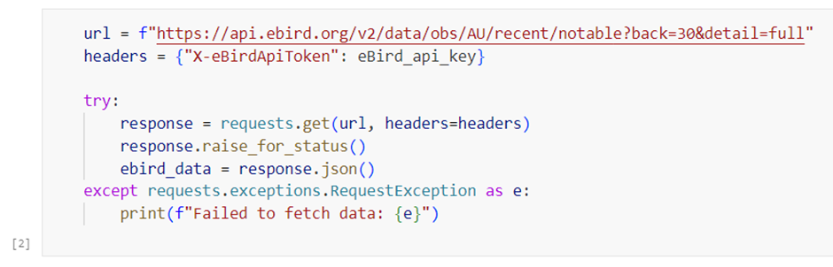
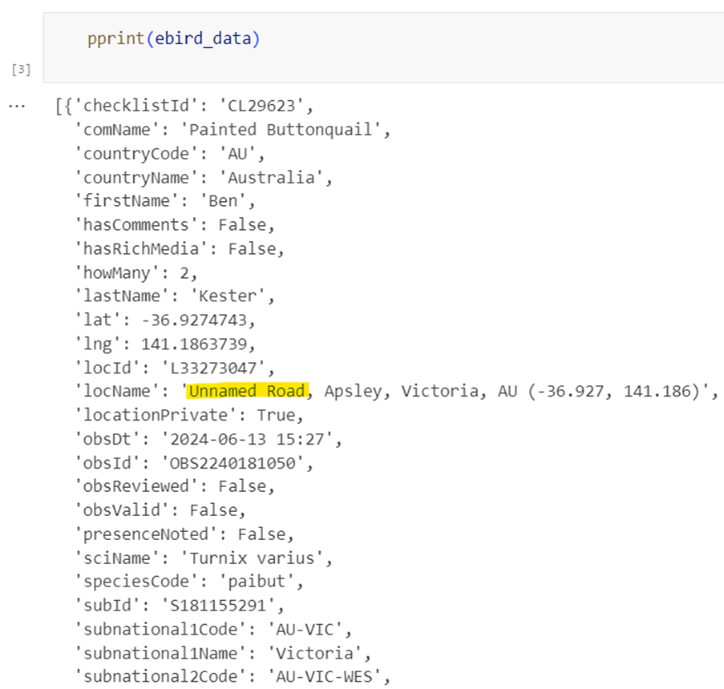
Sourcing the data
The eBird API call provided all details for each observation such as the bird name, location, observer name, and co-ordinates of the sighting of each bird etc
Limitations:
As the dataset only contained 30 days worth of data we could not analyse any historical observations to make further analysis of seasonal trends
Relies on multi user input which impacts the accuracy of location names

Slide 6
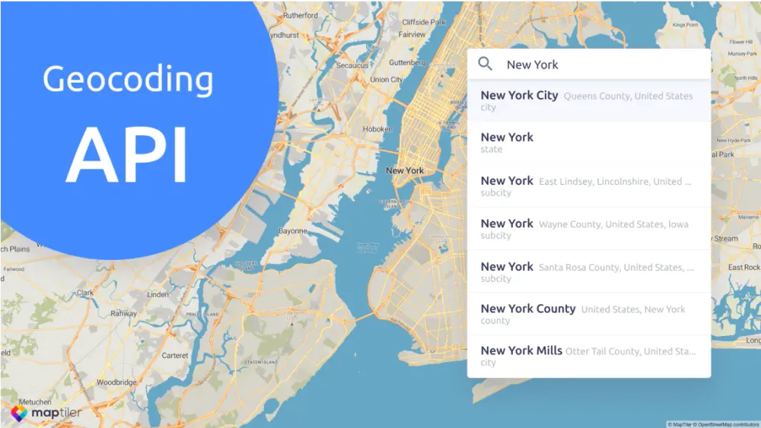
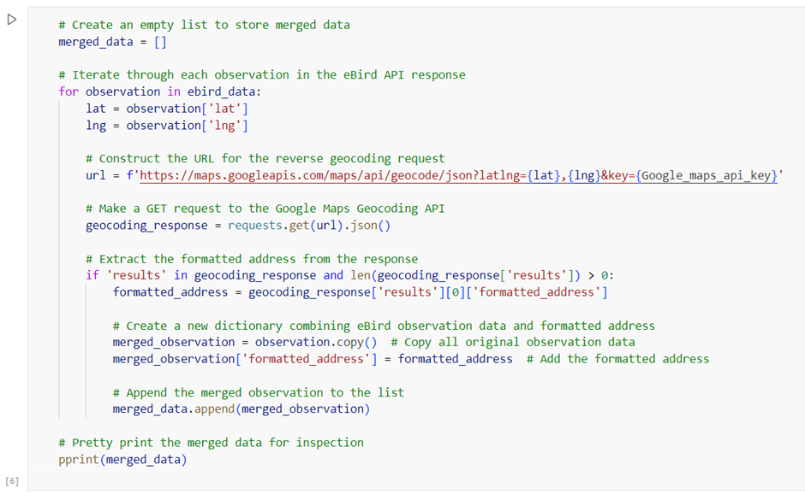
Updating the data
Using the Google Maps reverse Geocoding API and the co-ordinates as provided in the eBird API, we were able to amend the location names to show appropriate locations for each observation.
The Geocoding API also allowed us to group the data for easier visualisations of each observation location

Slide 7
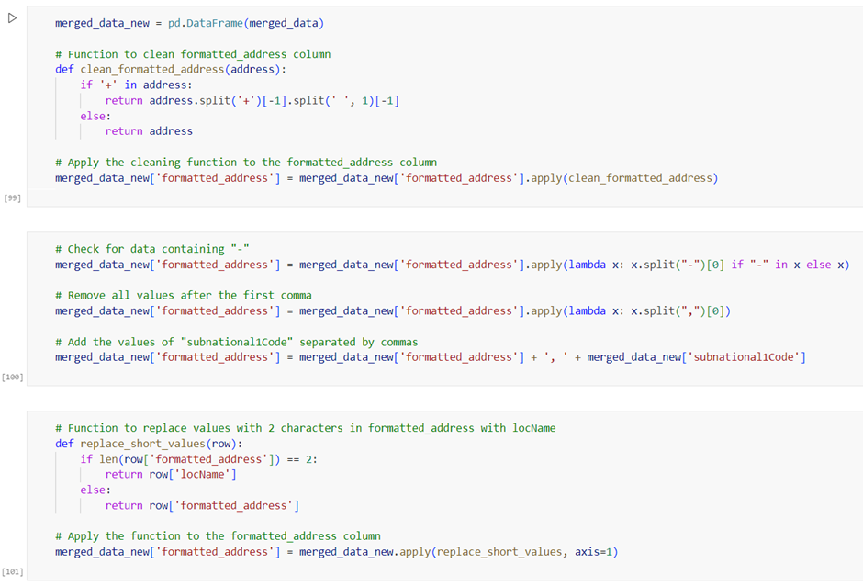
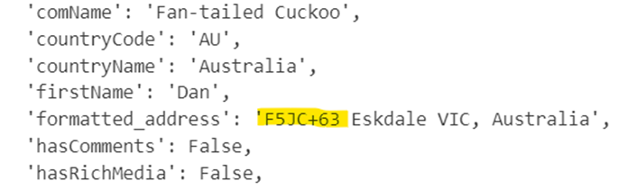

Cleaning the data
The geocoding API could not provide exact location names as some co-ordinates were not considered recognised addresses.
To avoid incorrect/unusable references for location, the “invalid” location was overwritten with a more broad location name, removing street numbers and only referencing, street name/suburb where available along with the state the observation was made.

Slide 8
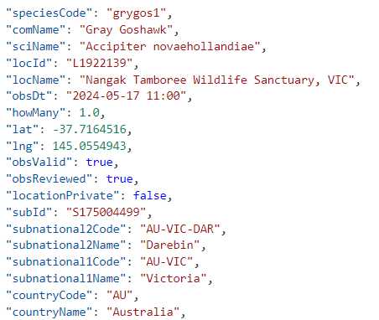
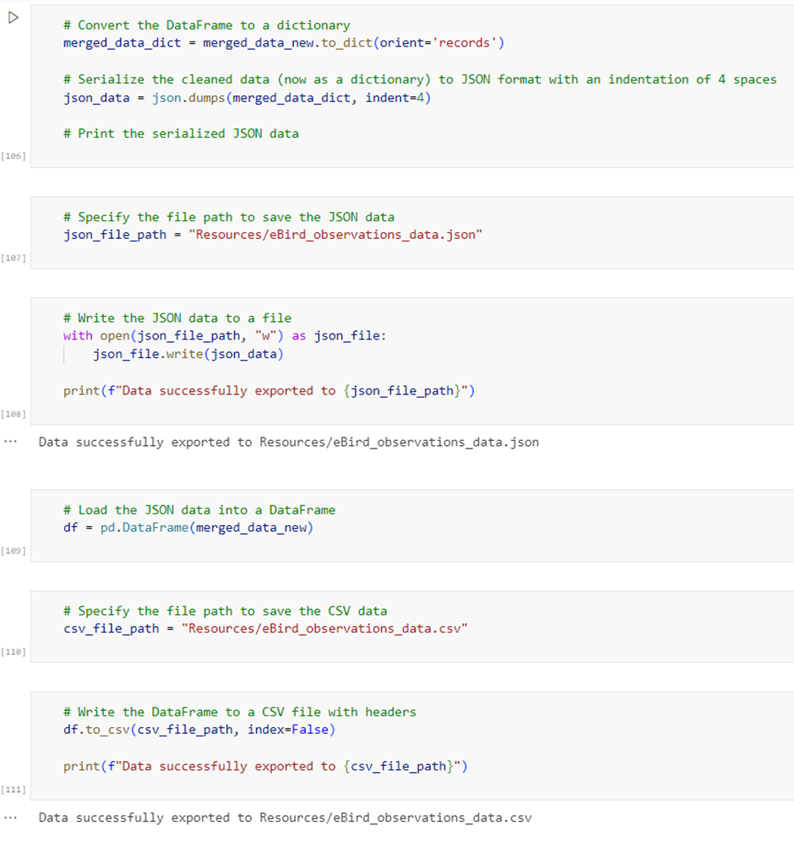
Exporting the data
As the data was continuously updating with each call to the eBird API,and was unpredictable as to what may be entered by the observers, we chose to export static files from the cleaned merged data as both CSV and JSON files to begin working on our visualisations

Slide 9
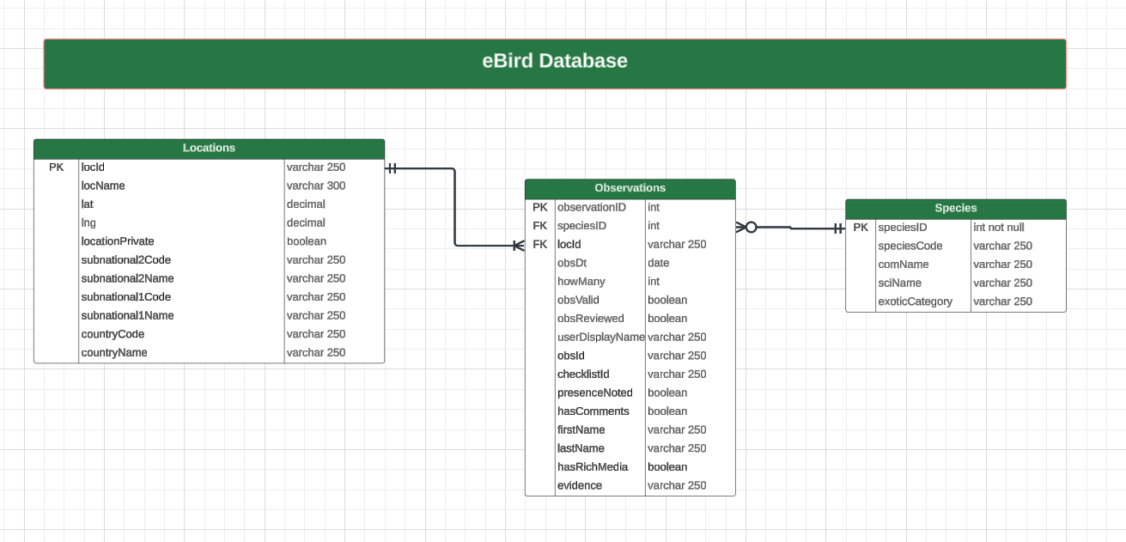
Importing data into a database
Step 1: Created an Entity Relationship Diagram

Slide 10
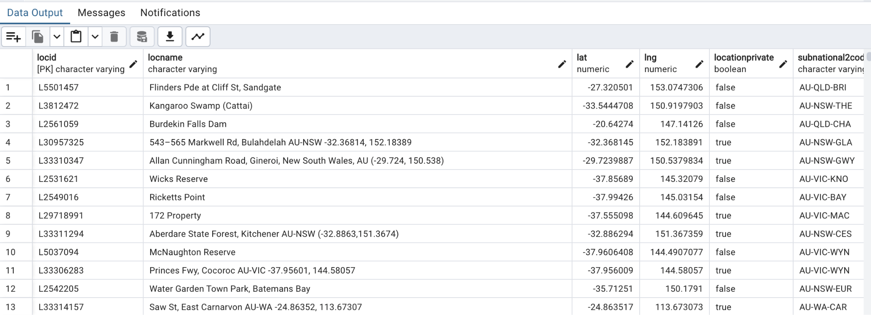
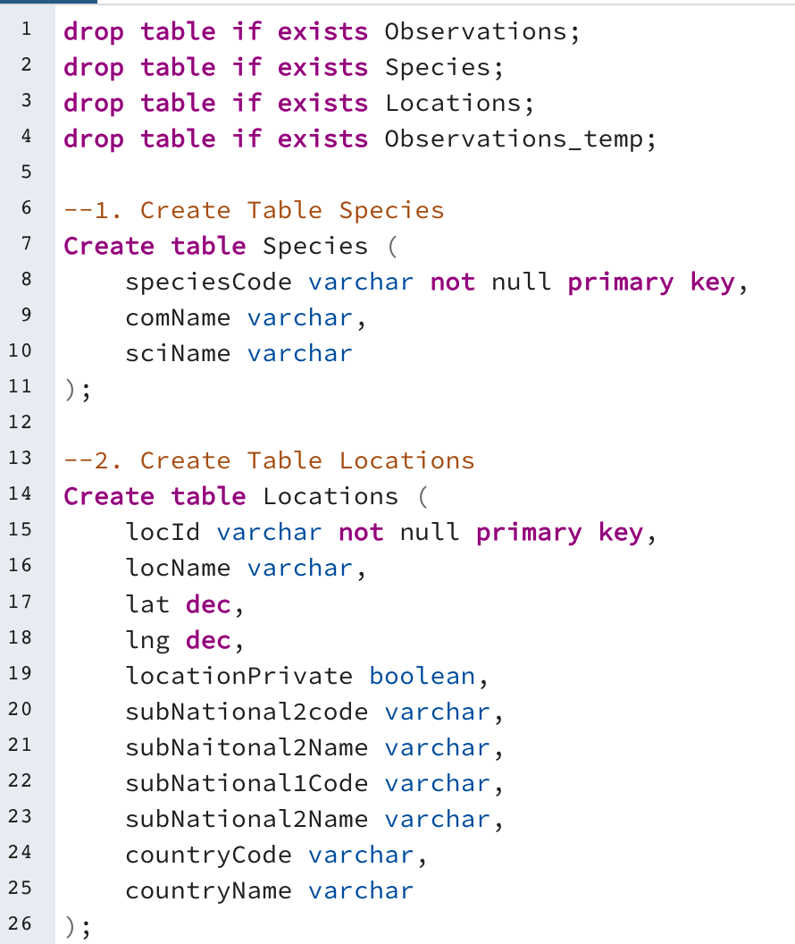
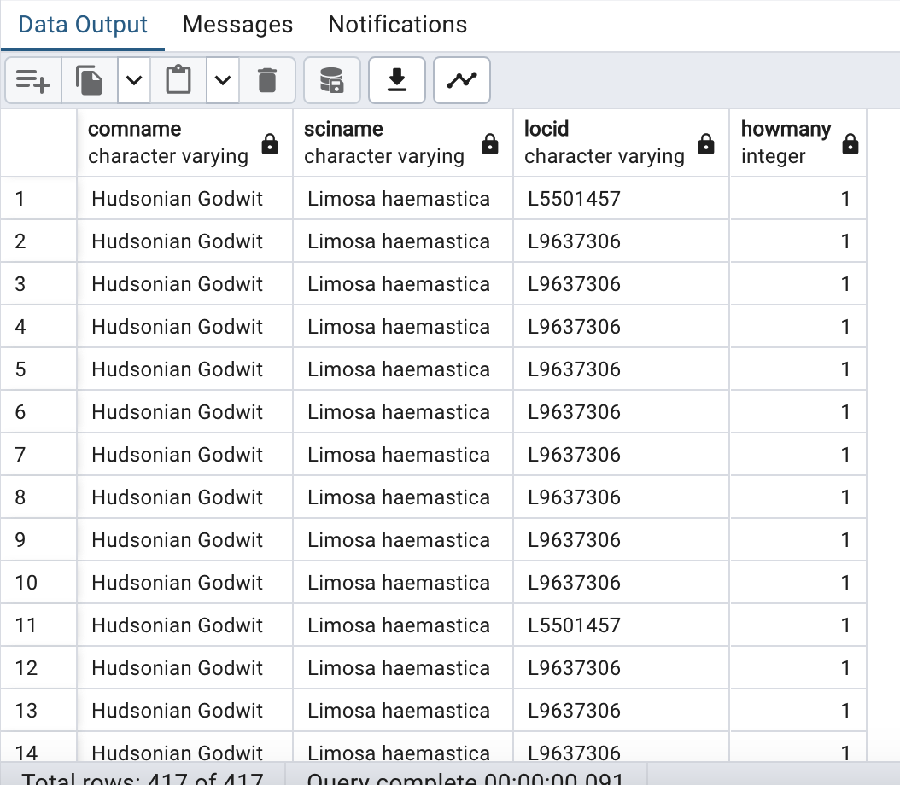
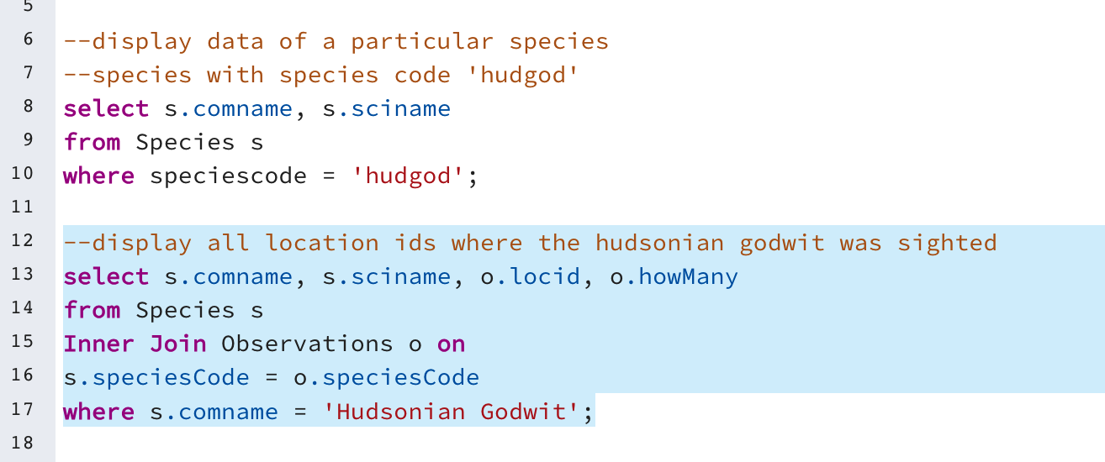
Step 2: Created tables & imported data
Step 3: Queried the data

Slide 11
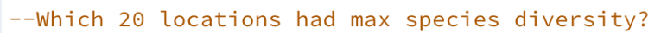
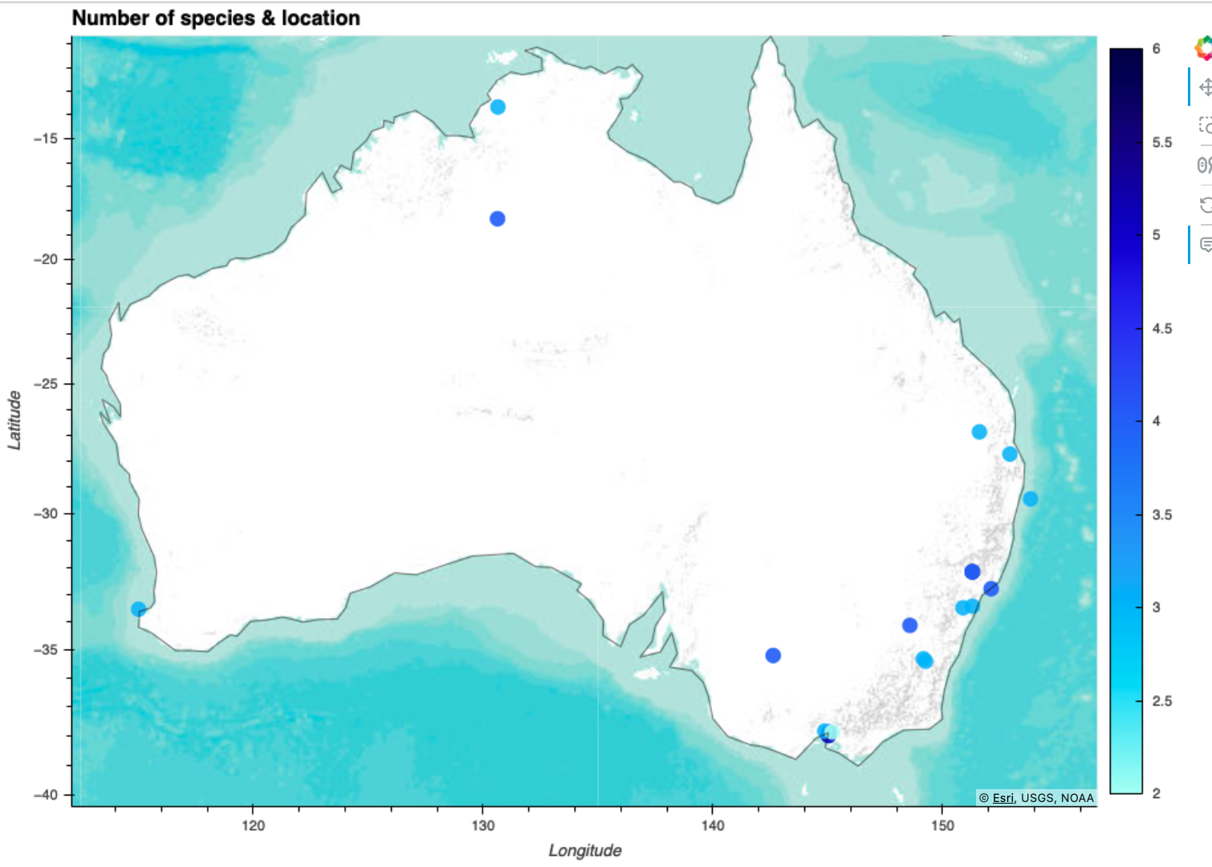
Queries for visualisations:

Slide 12
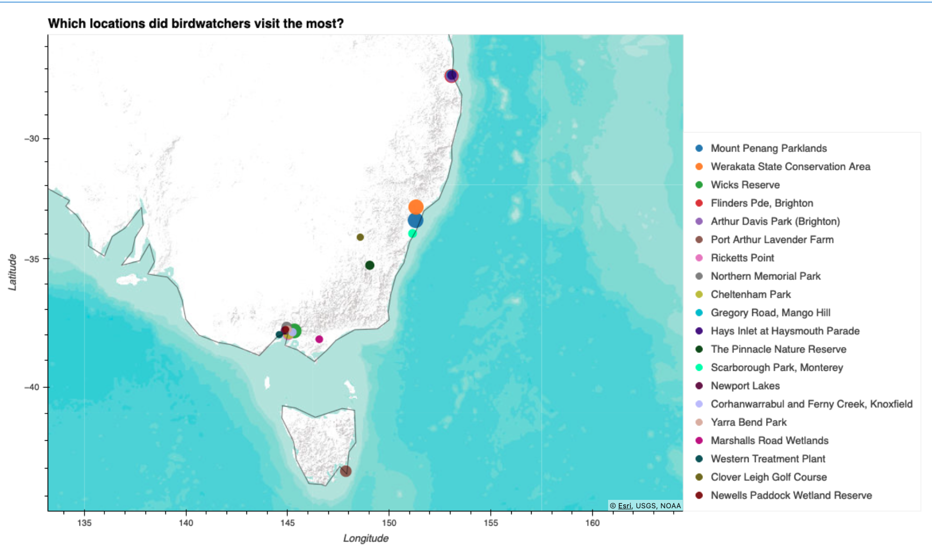

Slide 13
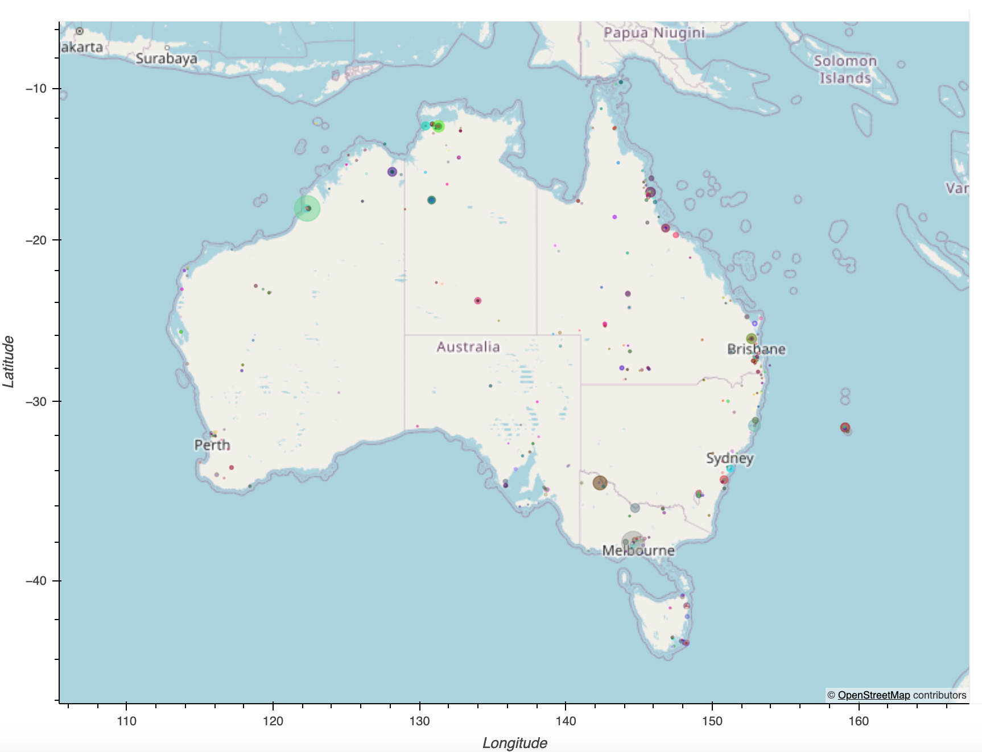
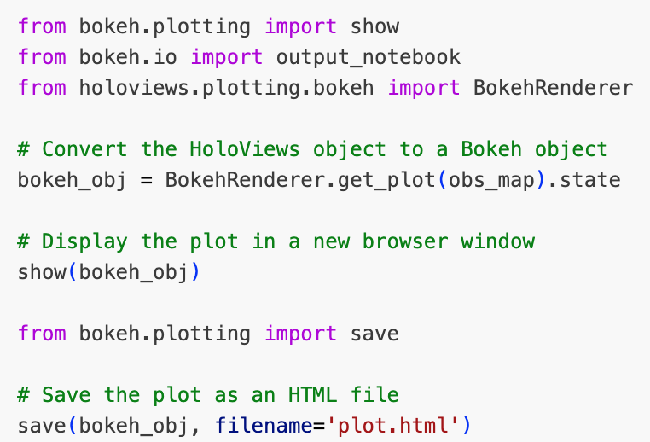
Total Bird Observations In Australia
Static visualisations in python
This is a map of Australia with various colored dots scattered across the continent. The total number of species observe in Australia is 696. Each color corresponds to a different bird species observed in Australia. The dots on the map, indicating where each species has been observed. This map provides valuable information about the geographical distribution of these bird species within Australia.

Slide 14
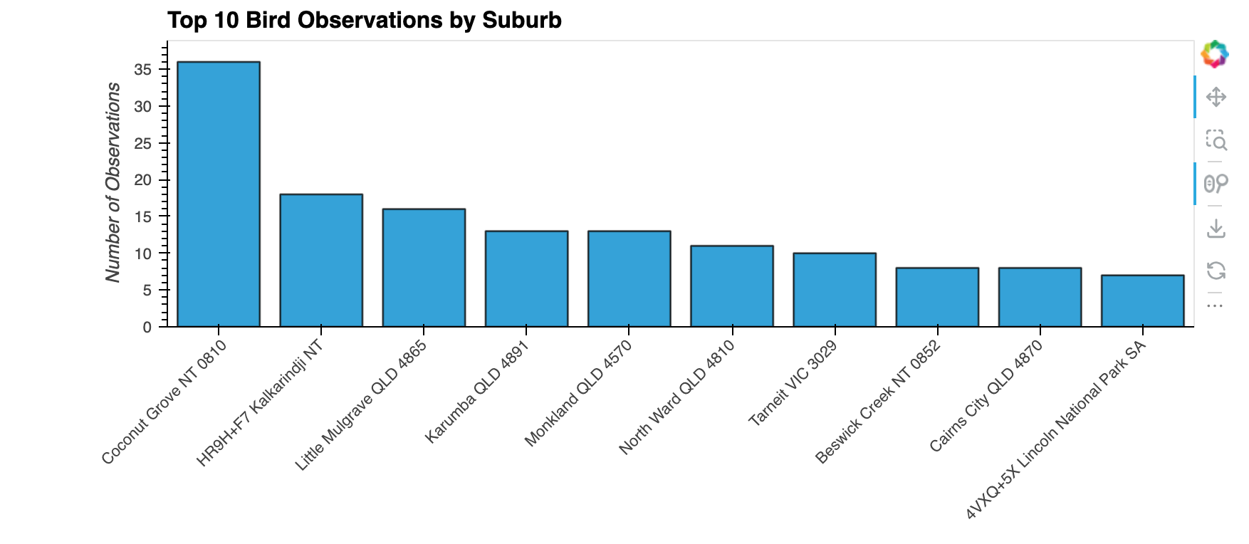
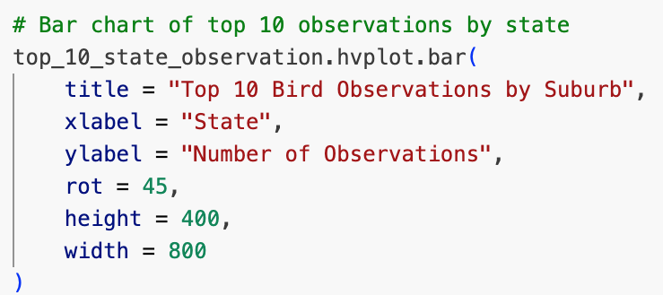
TOP 10 Bird Observations by Location
Top Location: Coconut Grove, NT has the highest number of bird observations, with 36 recorded sightings. Birdwatchers in this area have been quite active!
Least Obs. locations: Lincoln National Park , SA, Cairns City QLD and Beswick Creek NT has the fewest observations, with less than 7 recorded sightings. Perhaps it’s a less frequented spot for birdwatching.

Slide 15
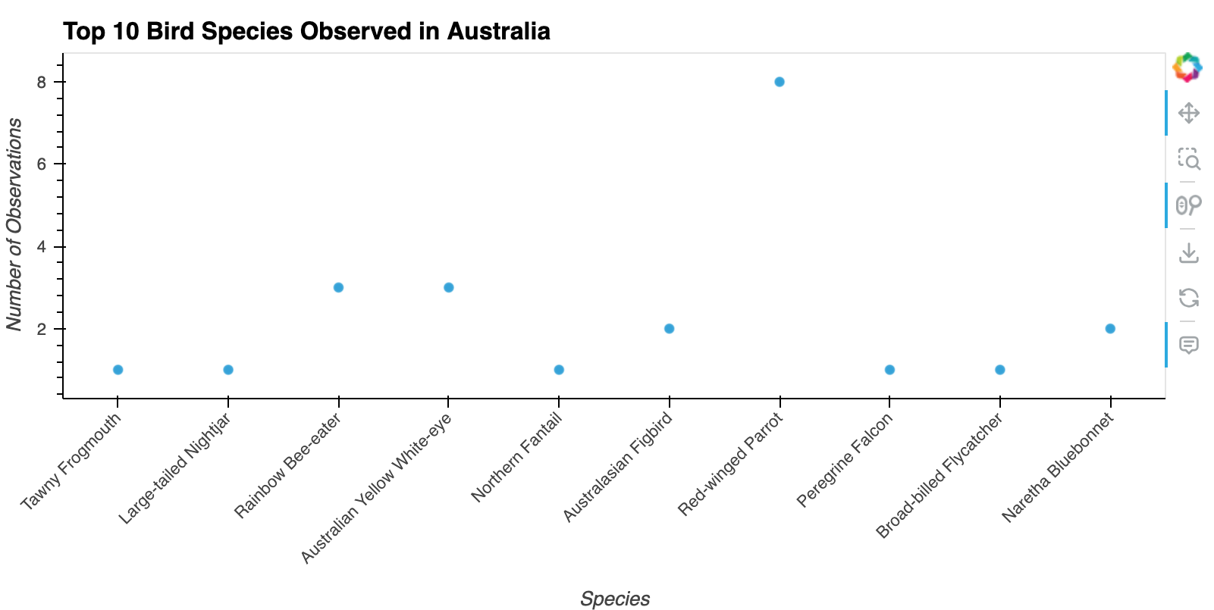
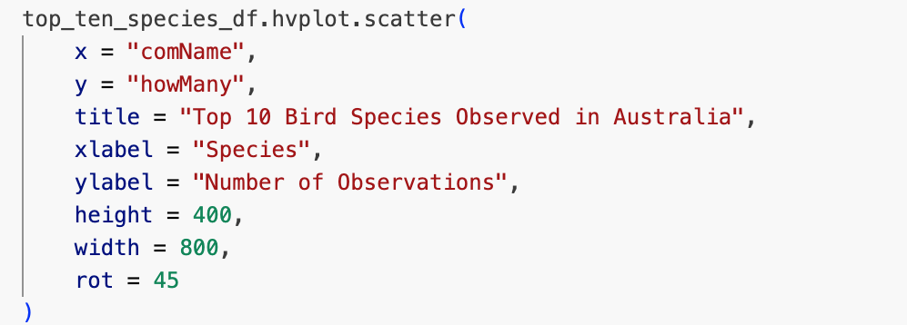
TOP 10 Bird Species Observed in Australia:
The Red Winged Parrot is the most frequently observed bird species (8 times) among those listed.
The least observed species (Once) are Tawny Frogmouth, Large-tailed Nightjar, Northern Fantail, Peregrine Falcon and Broad-billed Flycatcher.

Slide 16
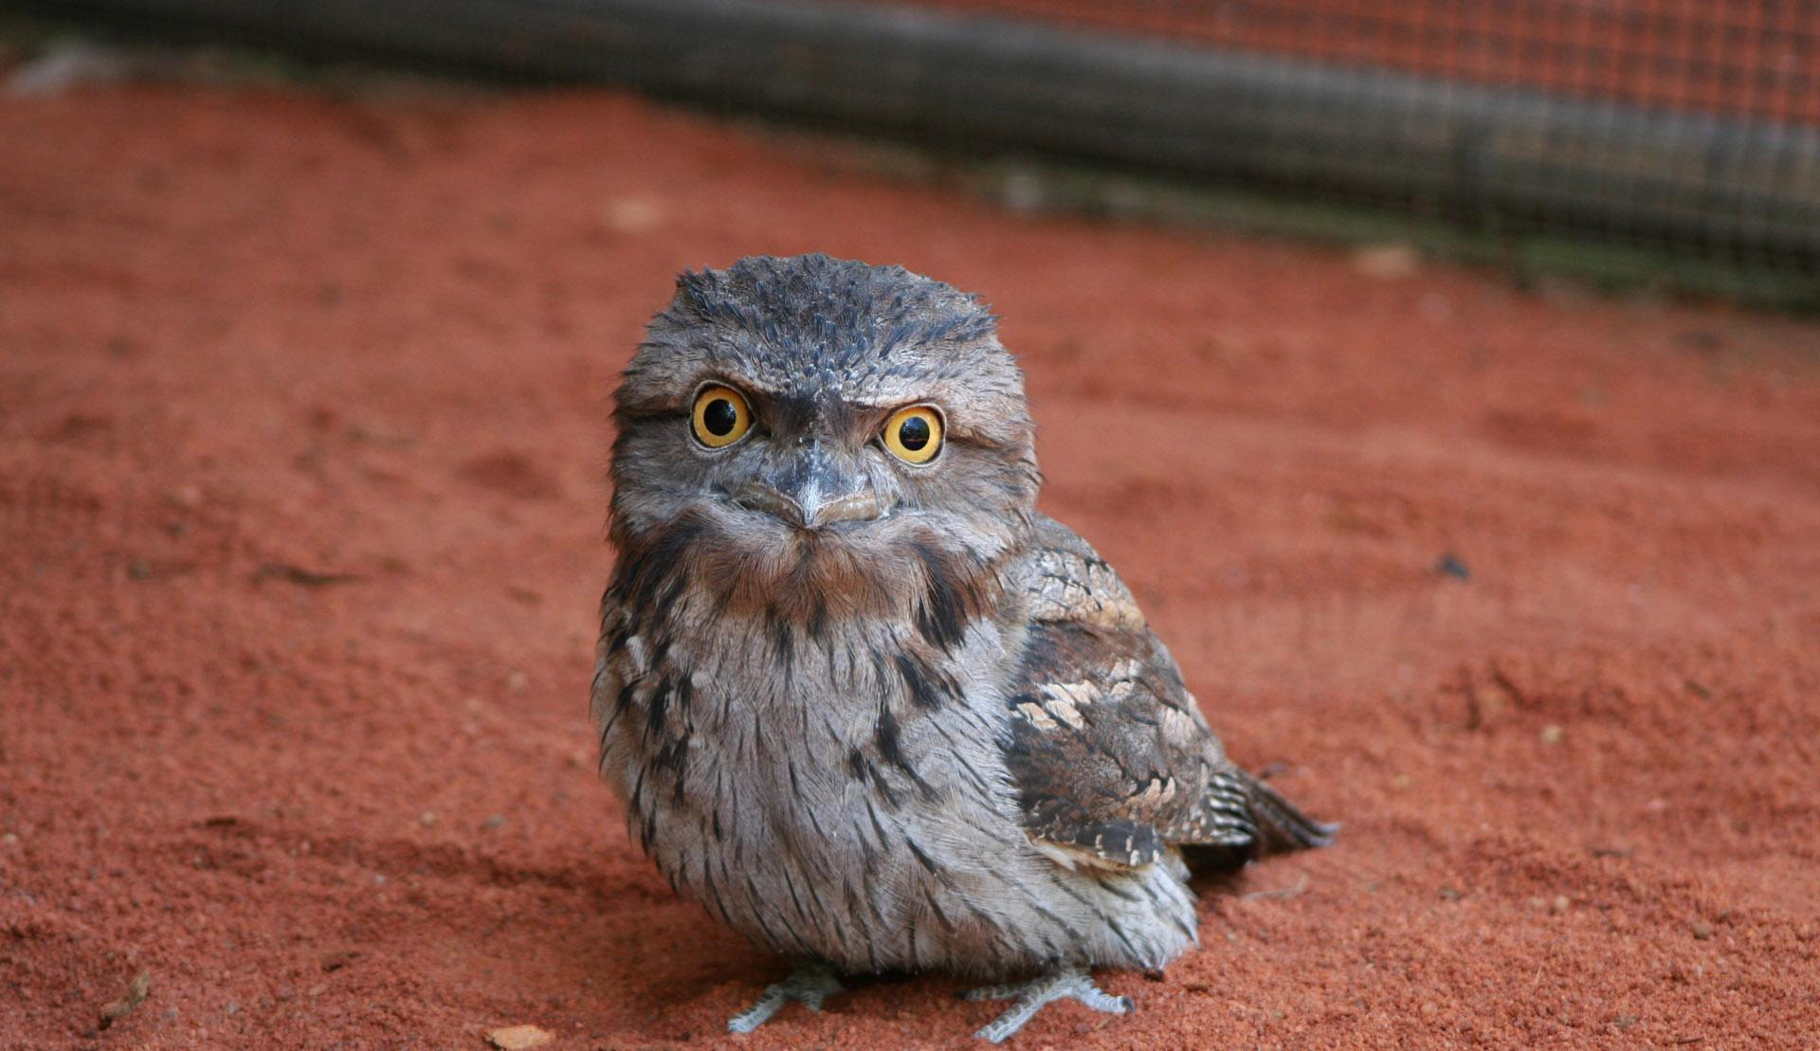
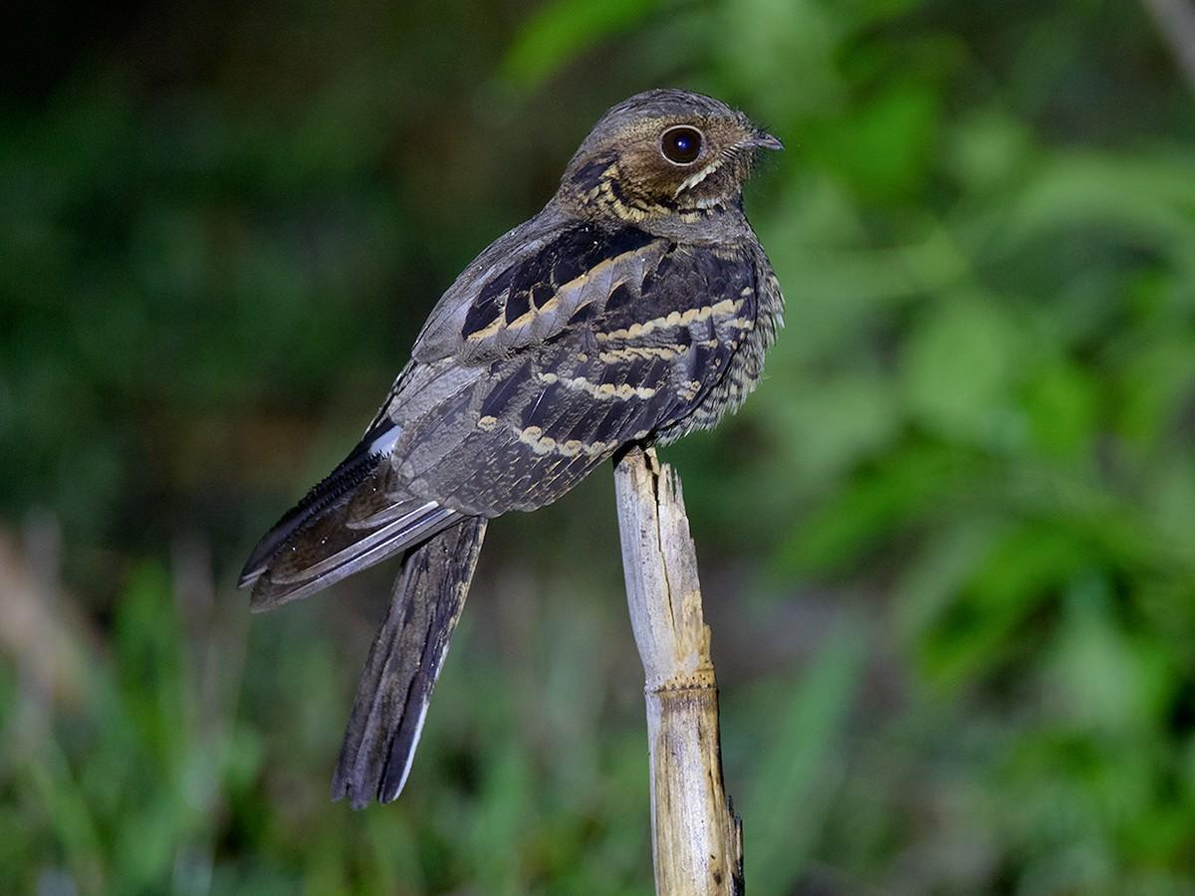
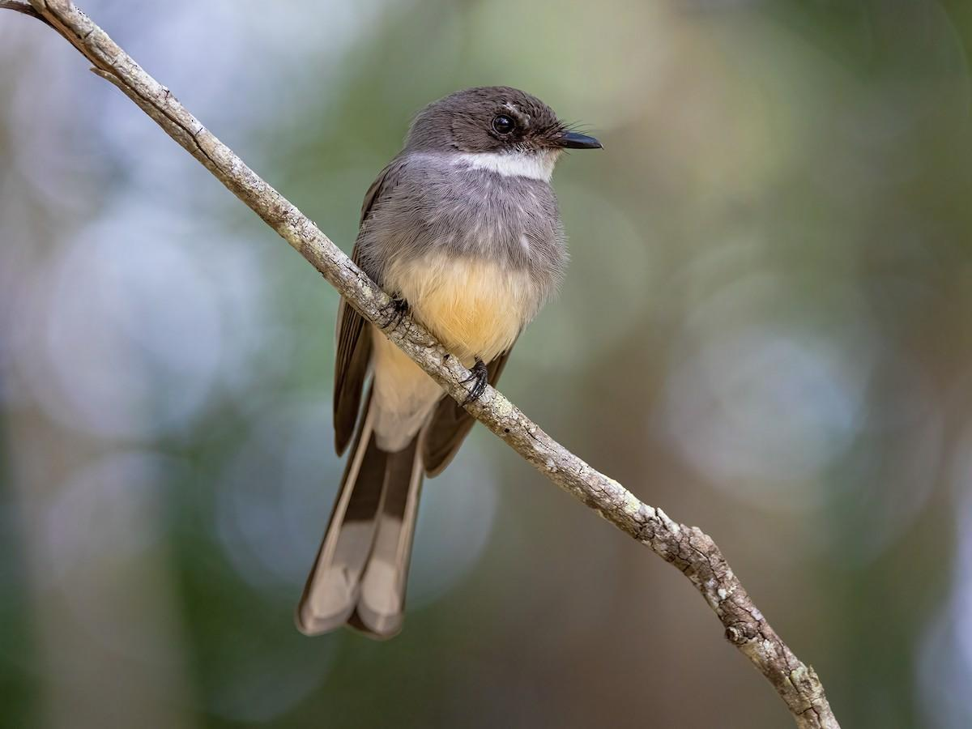
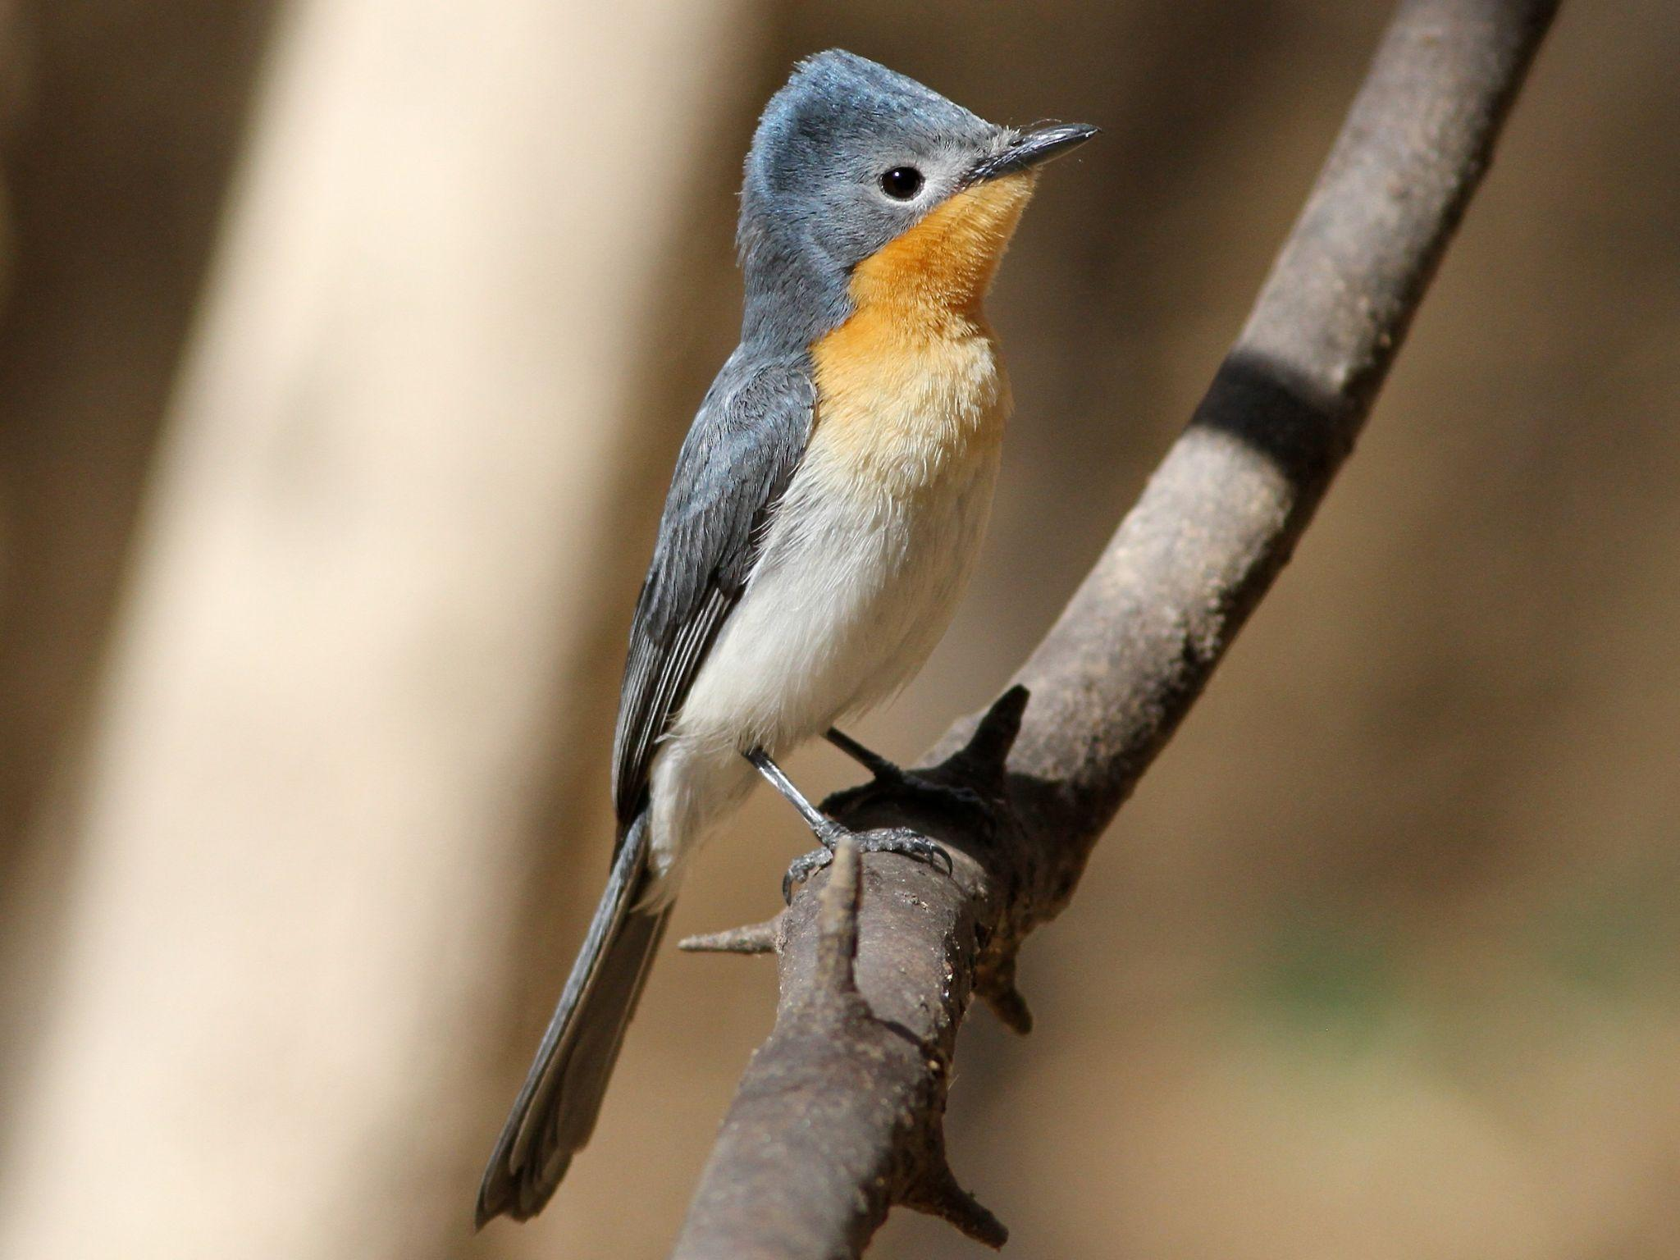
Tawny frogmouth - https://perthzoo.wa.gov.au/animal/tawny-frogmouth
Large-tailed Nightjar-https://ebird.org/species/latnig2
Northern fantail https://ebird.org/species/norfan1
Broad-billed Flycatcher https://ebird.org/species/brbfly1

Slide 17
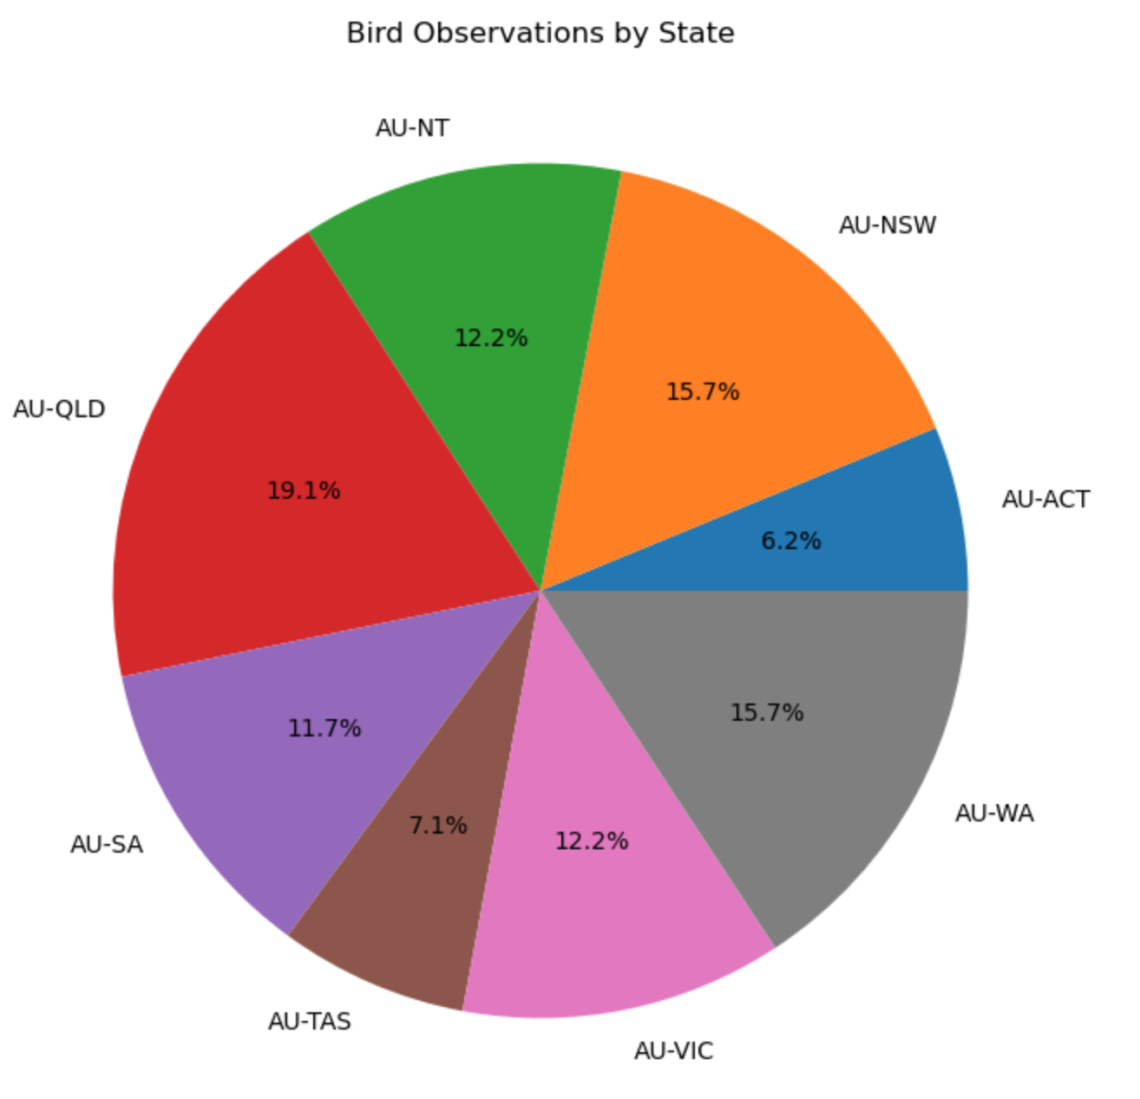
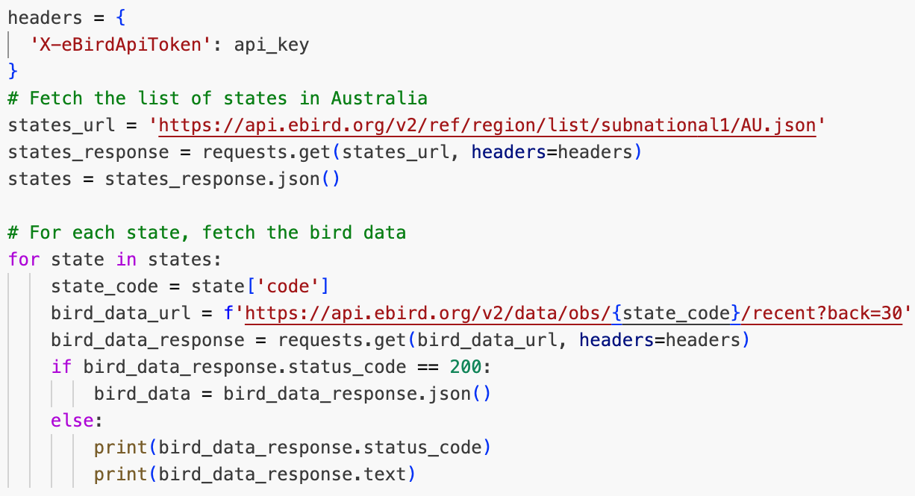
No. of Bird Observations by State
The state with the highest number of bird observations is Queensland, 19.1%, which approximately 500 observations.
The state with the fewest bird observations is ACT, 6.2% and TAS 7.1%, which is approximately 163 and 186 observations.

Slide 18
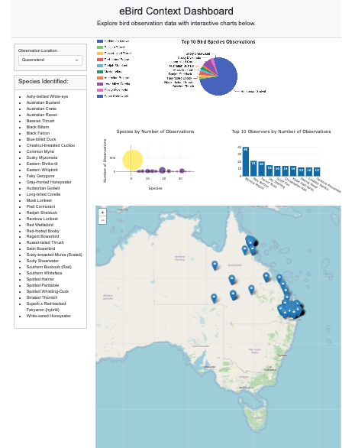
eBird Context Dashboard
Objective
The eBird Context Dashboard provides an interactive platform for exploring bird observation data, allowing users to visualize and analyze bird species, observer activities, and observation locations across different regions.
Components and Functionality
User Interface:
Dropdown Menu: Users can select a state to view specific bird observation data.
Cards and Containers: Information is neatly organized into cards and containers, displaying species identified.

Slide 19
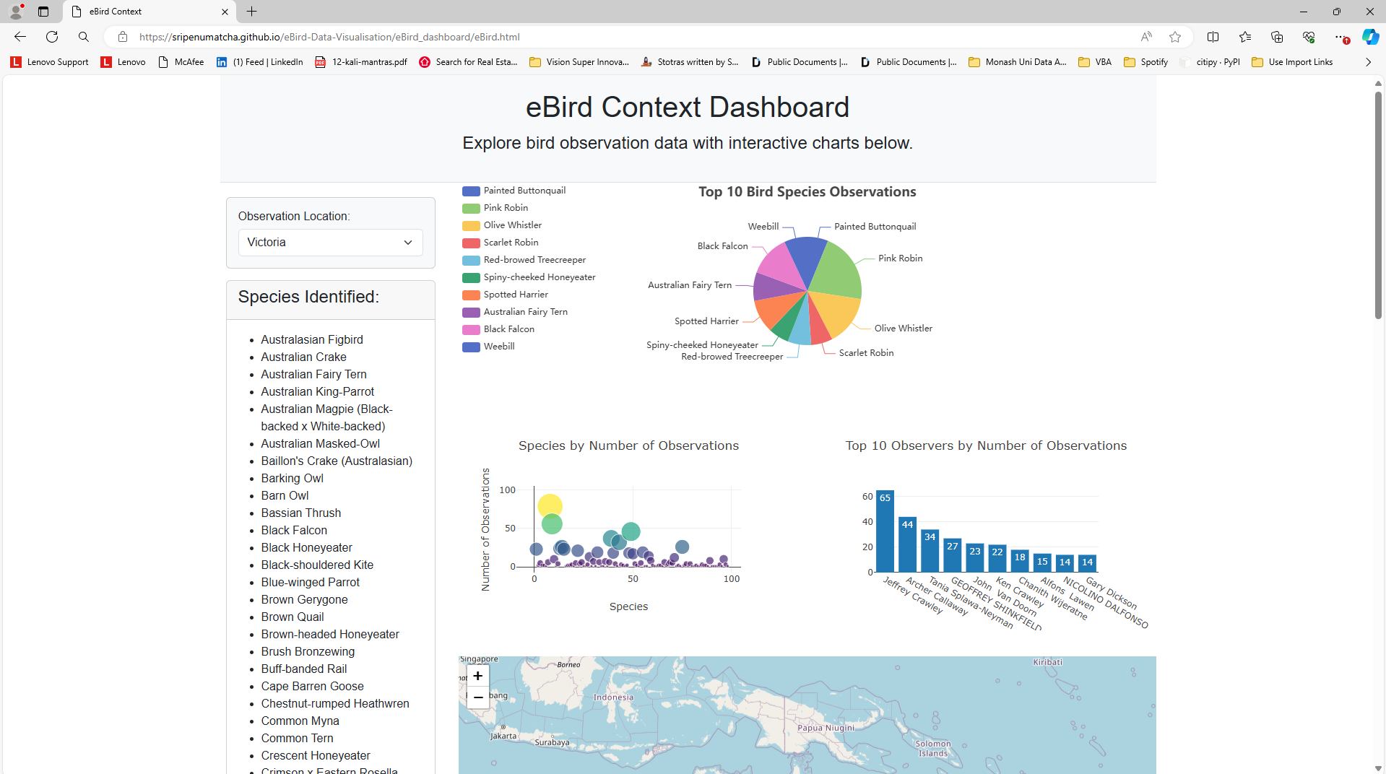
Visualizations:
Pie Chart: Displays the top 10 bird species observations in the selected state using ECharts.
Bubble Chart: Visualizes species observations with bubbles sized according to the number of observations using Plotly.
Bar Chart: Shows the top 10 observers by the number of observations using Plotly.
Map: Interactive map displaying observation locations with markers using Leaflet.
Data Handling:
CSV Data Fetching: Bird observation data is fetched from a CSV file hosted online.
State Filtering: Users can filter observations by selecting a state, which updates all visualizations and information accordingly.
Top Observers and Species: The dashboard computes the top 10 observers and top 10 bird species based on the filtered data.
o

Slide 20

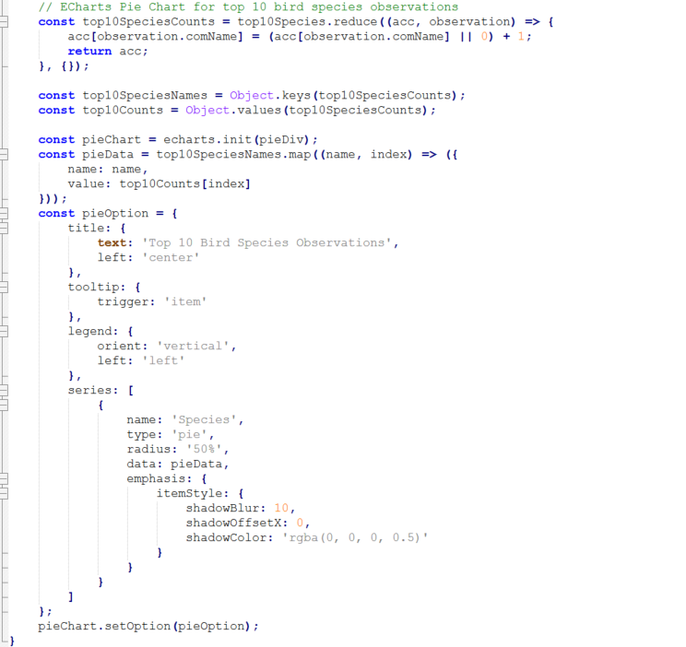
View eBird Dashboard
Technical Implementation:
HTML and CSS: Provides the structure and styling for the dashboard.
JavaScript: Handles data fetching, processing, and visualization updates.
Libraries Used:
D3.js: For data manipulation and CSV parsing.
Plotly: For creating bar and bubble charts.
ECharts: For rendering the pie chart.
Leaflet: For creating the interactive map
Key Features
Interactive Selection: Users can dynamically change the state selection, and the dashboard updates all relevant data and visualizations accordingly.
Comprehensive Visualization: Multiple chart types and an interactive map provide a holistic view of bird observation data.
Data-Rich Insights: Detailed information about the top bird species and top observers is readily accessible.
Conclusion
The eBird Context Dashboard serves as an effective tool for bird enthusiasts, researchers, and conservationists to explore and analyze bird observation data interactively. Its user-friendly interface and robust data visualization capabilities provide valuable insights into bird species distributions and observer activities across different regions.

Slide 21
Thanks.

